Slide 1

OLIST MARKETING DATASET ANALYSIS

Slide 2

TEAM MEMBERS:
Tanushree Deshmukh
Varada Dharmadhikari
Saumil Shah

Slide 3
CONTEXT
The Olist Marketing Funnel dataset contains information about Marketing Qualified Leads(MQLs) who were contacted between June 1st, 2017 and July 1st , 2018.
Some of these MQLs were then listed as sellers on the Olist website.
The aim of this project is to analyze the Origin, Business Segment and Type of these MQLs – Marketing Leads Analysis
The 2nd dataset used is the Brazilian E-commerce website dataset.
This dataset provides information about the sellers, customers, products, payments and orders.
We have generated reports for Sales and Marketing Analysis and Finance and Operations Analysis

Slide 4






TOOLS USED

Slide 5





Incoming Data
Data Source
Initial Data Processing
Data Ingestion
Data Storage
Database
Visualization
Data Analysis
VISION DIAGRAM
Brazilian E-commerce Data: csv files
Profiling & Cleansing
Apache Cassandra
Marketing Leads
Seller csv
Product csv
Customer csv
Payment csv
Geospatial csv
PowerBI
Simba Connector

Slide 6
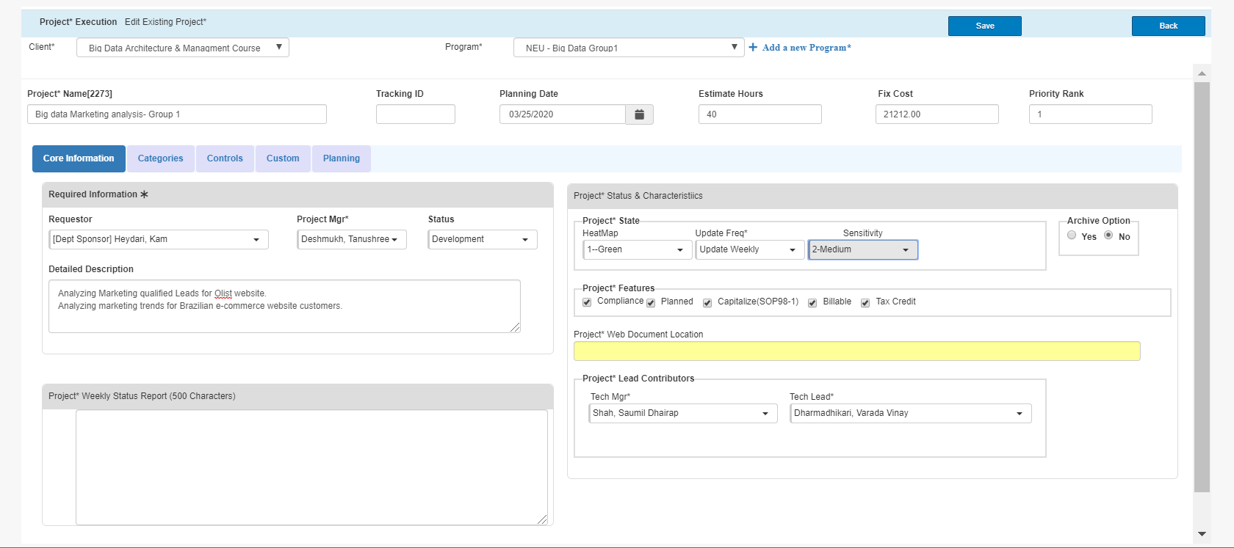
VELERO OVERVIEW

Slide 7
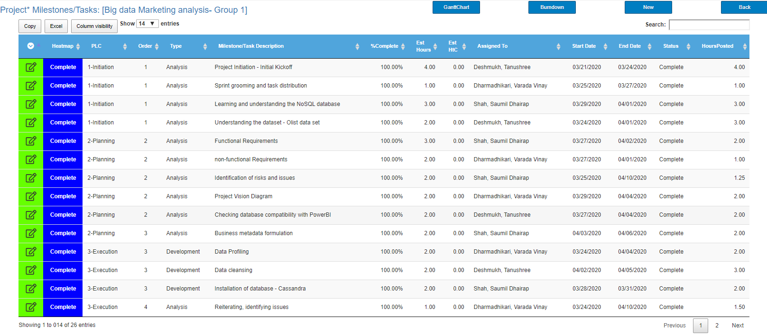
PROJECT PLAN

Slide 8
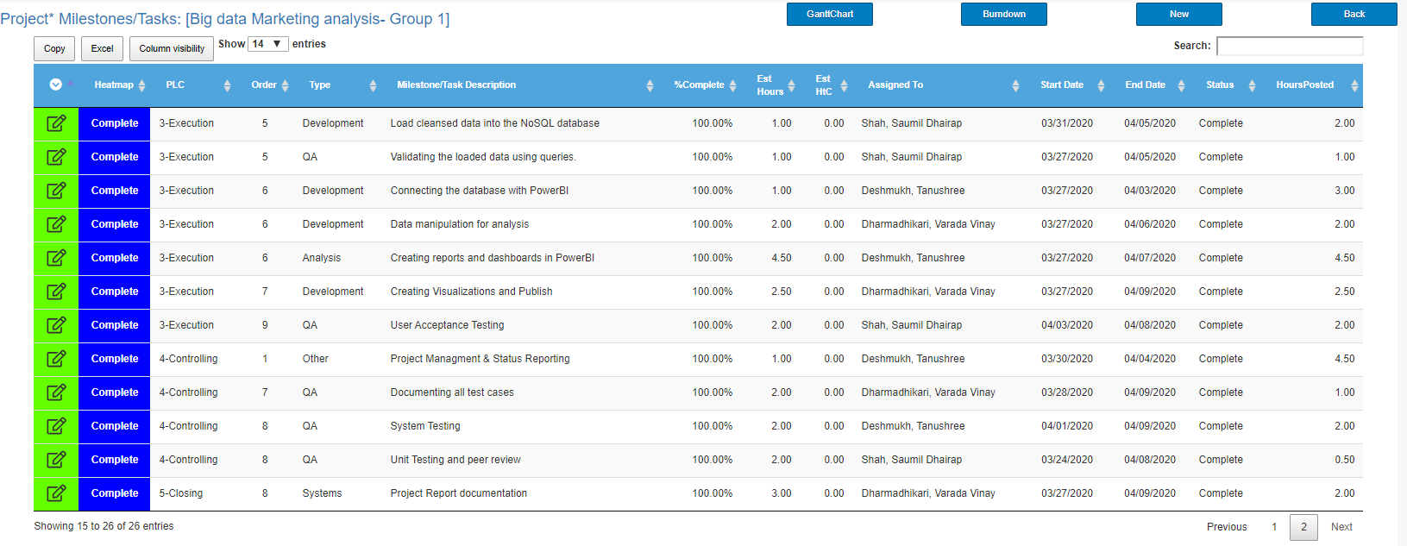

Slide 9
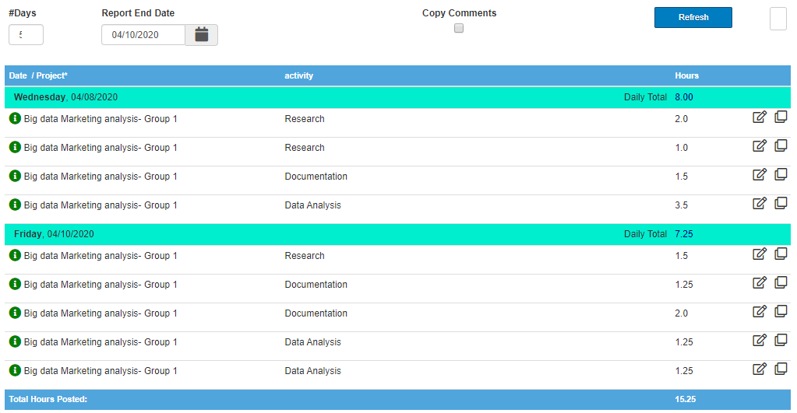
TIMESHEET

Slide 10
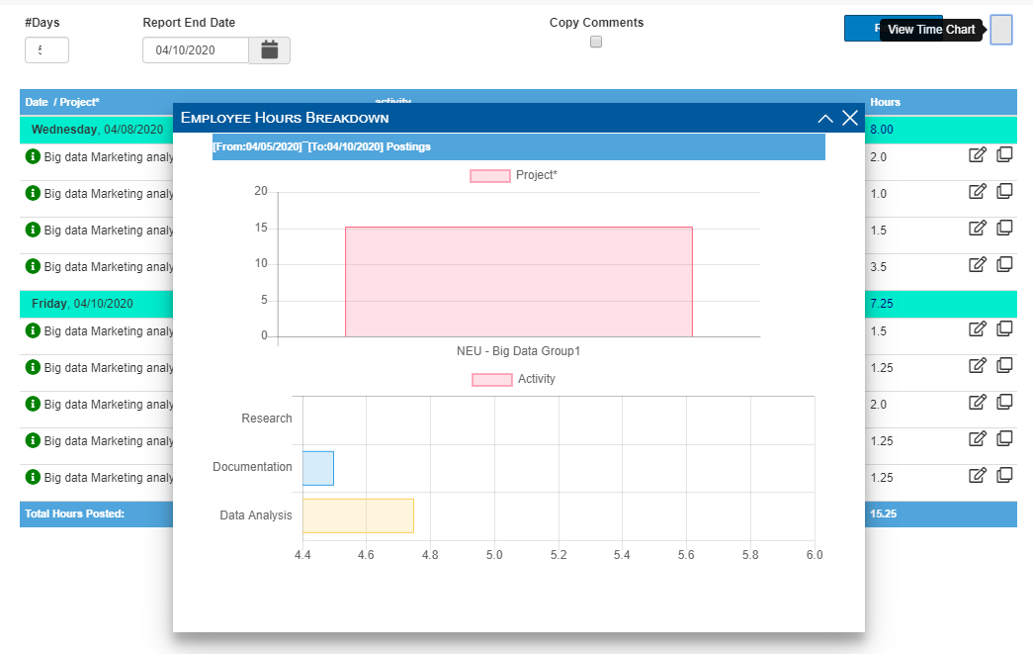
TIMESHEET

Slide 11


END USERS
E-commerce website Marketing team
E-commerce website’s Financial team
Sellers’ marketing team
Sellers’ advertising and Sales teams

Slide 12
Risks and Issues
Issue - Python version issue while installing Cassandra
Issue - Null values in the dataset
Risk - Joining to geospatial dataset due to various latitude and longitude values for a single zip code
Issue - Connector issues for Cassandra and PowerBI
Issue - Transforming data in PowerBI

Slide 13


RESOLVING ENCOUNTERED ISSUES
Python version issue: Apache Cassandra is not supported on Python version 3.7
How did we fix it?
We found out that Cassandra is supported on Python 2.7 and then installed that.

Slide 14
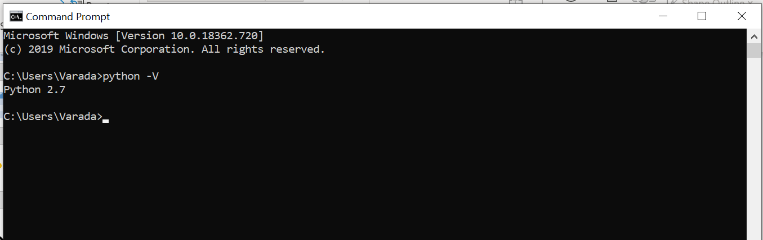
Installed the correct python version for Cassandra

Slide 15
RESOLVING ENCOUNTERED ISSUES
Null values in the dataset
How did we fix it?
Replaced null values with ‘Unknown’

Slide 16
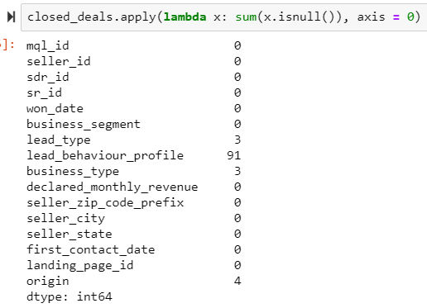
Null Values

Slide 17
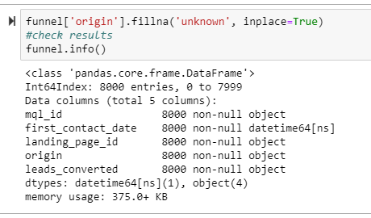
Replacing all null values with ‘Unknown’

Slide 18
RESOLVING ENCOUNTERED ISSUES
Connector issues for Cassandra and PowerBI
How did we fix it?
Made use of Simba Connector to connect Cassandra and Power BI

Slide 19
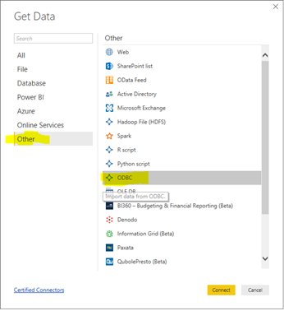
Connecting Cassandra and Power BI with Simba ODBC connector

Slide 20
RESOLVING ENCOUNTERED ISSUES
Transforming data in Power BI
How did we fix it?
Some date data was stored as text in Power BI, we then transformed this data to the date type and used it for analysis

Slide 21
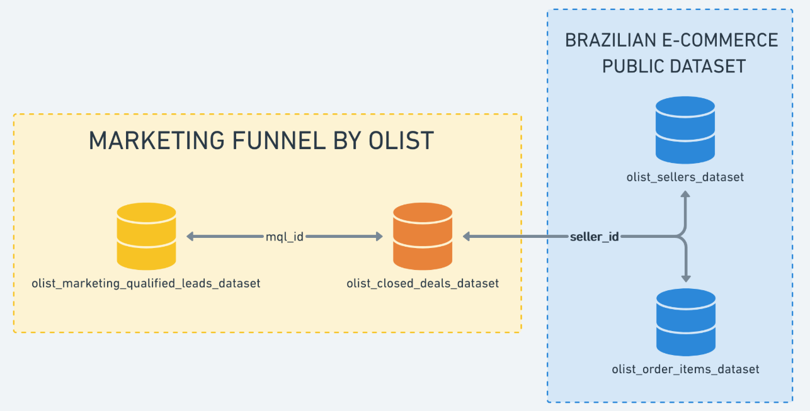
BUSINESS METADATA AND DATA MODEL
Dataset Repository:
Marketing Funnel by Olist
Dataset from sellers that filled-in requests of contact to sell their products on Olist Store
https://www.kaggle.com/olistbr/marketing-funnel-olist

Slide 22
Business Metadata – Details
Olist_closed_deals_dataset
mql_id | Marketing Qualified Lead id
seller_id | Seller id
sdr_id | Sales Development Representative id
sr_id | Sales Representative
won_date | Date the deal was closed
lead_type | Lead type. Informed on contact
business_segment | ead business segment. Informed on contact

Slide 23
Business Metadata – Details
Olist_marketing_qualified_leads_dataset
mql_id | Marketing Qualified Lead id
first_contact_date | Date of the first contact solicitation
landing_page_id | Landing page id where the lead was acquired
origin | Type of media where the lead was acquired
Custom Fields
leads_converted | Yes/No depending on if a lead converted or not
date_diff | time taken to convert a lead

Slide 24
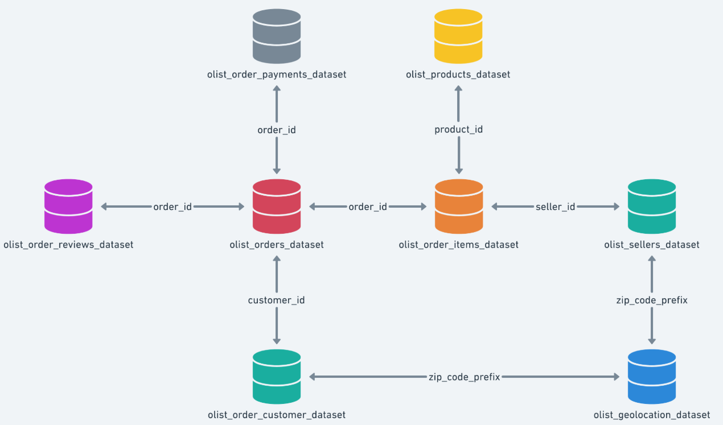
BUSINESS METADATA AND DATA MODEL
Dataset Repository:
Brazilian e-commerce dataset
https://www.kaggle.com/olistbr/brazilian-ecommerce/home#olist_customers_dataset.csv

Slide 25
Business Metadata
olist_order_items_dataset (Line Item)
order_id | order unique identifier
order_item_id | sequential number identifying number of items included in the same order
product_id | product unique identifier
seller_id | seller unique identifier
shipping_limit_date | Shows the seller shipping limit date for handling the order over to the logistic partner
price | item price
freight_value | item freight value item (if an order has more than one item the freight value is splitted between items)
olist_customers_dataset
customer_id | key to orders dataset. Each order has a unique customer_id
customer_unique_id | unique identifier of a customer
customer_zip_code_prefix | first five digits of customer zip code
customer_city | customer city name
customer_state | customer state name

Slide 26
Business Metadata – Continued
olist_order_payments_dataset
olist_sellers_dataset
order_id | order unique identifier
payment_sequential | customer may pay an order with more than one payment method. If he does so, a sequence will be created to accommodate all payments
payment_type | method of payment chosen by the customer
payment_installments | number of installments chosen by the customer
payment_value | transaction value
seller_id | seller unique identifier
seller_zip_code_prefix | first 5 digits of seller zip code
seller_city | seller city name
seller_state | seller state name

Slide 27
Business Metadata – Continued
olist_orders_dataset
order_id | unique identifier of the order
customer_id | key to the customer dataset. Each order has a unique customer_id
order_status | Reference to the order status (delivered, shipped, etc)
order_purchase_timestamp | Shows the purchase timestamp
order_approved_at | Shows the payment approval timestamp
order_delivered_carrier_date | Shows the order posting timestamp. When it was handled to the logistic partner
order_delivered_customer_date | Shows the actual order delivery date to the customer
order_estimated_delivery_date | Shows the estimated delivery date that was informed to customer at the purchase moment

Slide 28
Business Metadata – Continued
olist_products_dataset
product_id | unique product identifier
product_category_name | root category of product, in Portuguese
product_name_lenght | number of characters extracted from the product name
product_description_lenght | number of characters extracted from the product description
product_photos_qty | number of product published photos
product_weight_g | product weight measured in grams
product_length_cm | product length measured in centimeters
product_height_cm | product height measured in centimeters
product_width_cm | product width measured in centimeters

Slide 29
Functional Requirements
Functional Requirement Code | Category | Description | Status
UD-1 | User Specific Dashboard | Build reports specific to the Sales and marketing teams of the e-commerce website, and the sellers listed on the website | Completed
UD-2 | User Specific Dashboard | Build reports specific to the finance teams of the e-commerce website and the sellers listed on the website | Completed
UD-3 | User Specific Dashboard | Build reports for Marketing Lead Analysis | Completed

Slide 30
Non-Functional Requirements
Non-Functional Requirement Code | Description | Status( Y/N)
NFR-1 | Ease of access and serviceability of built dashboards | Y
NFR-2 | Maintaining dashboards as new data is updated | Y
NFR-3 | Making sure that no sensitive information is leaked or published | Y

Slide 31
Business Content
Our aim is to analyze data sets in detail and suggested recommendations for decision making in business. Some of the pointers are :
To find total / monthly conversion rate for the leads
Number of customers by Product Category
Average price per Product / Product Category
Number of Products sold by seller / city
Revenue generated yearly / monthly

Slide 32
Technical Metadata
File Name & Size | Marketing Funnel by Olist 855KB Brazilian E-Commerce Public Dataset by Olist 120MB
Type of Compression | Zip
OS used to run software | Windows
Hardware Processor Name | Intel(R) Core i7
Hardware RAM | 16 GB
Database Used | Cassandra
Tools Used | PowerBI, JupyterNotebook, Microsoft Excel,Velero
Connector Name (for connecting database to PowerBI ) | Simba

Slide 33
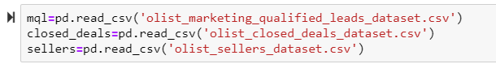
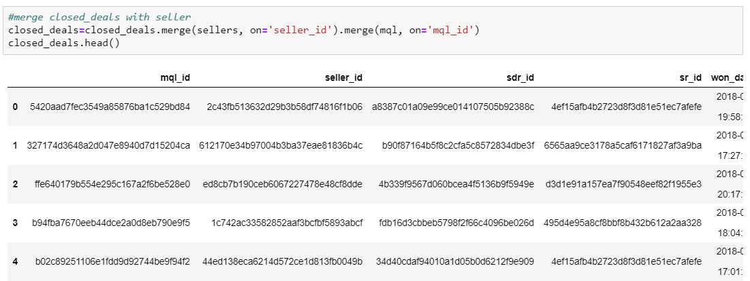
Loading and merging Data for cleansing in Pandas
Inserting marketing leads database:
Merging the datasets

Slide 34
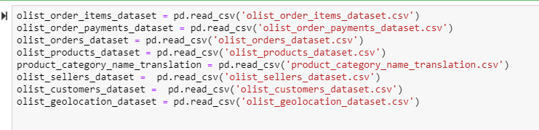
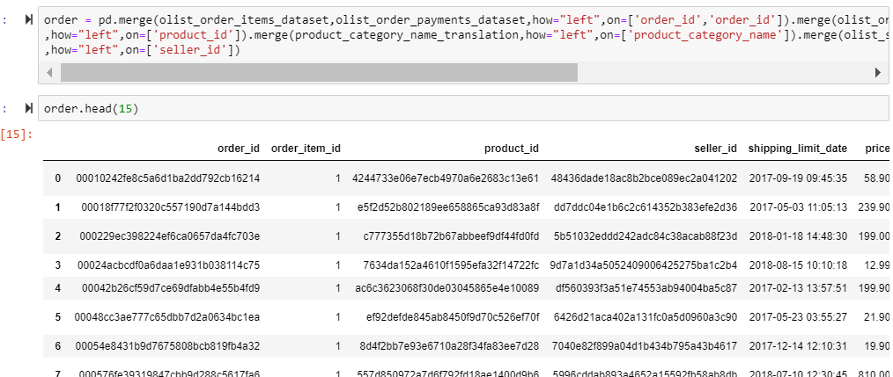
Loading and merging Brazilian e-commerce dataset
Loading and merging the datasets

Slide 35
Download and Install Cassandra
Install Latest JRE if you haven’t installed it already.
To check if it is installed à go to cmd à type jre -version
It should be 1.8 and above or else download and install from this link “https://www.oracle.com/technetwork/java/javase/downloads/jre8-downloads-2133155.html”
Choose Windows 64 if your system is windows 64 or else X86
Step 2: Setup the Path to the environment variable
Once you install JRE, Add the path of the JRE to your path
To do this go to start >> edit environment variables for your account >>

Slide 36
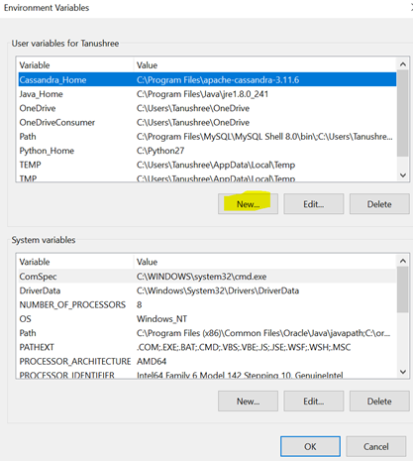
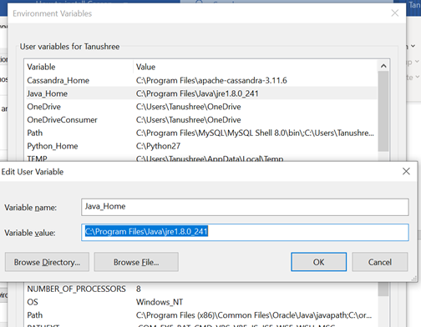
Download and Install Cassandra

Slide 37
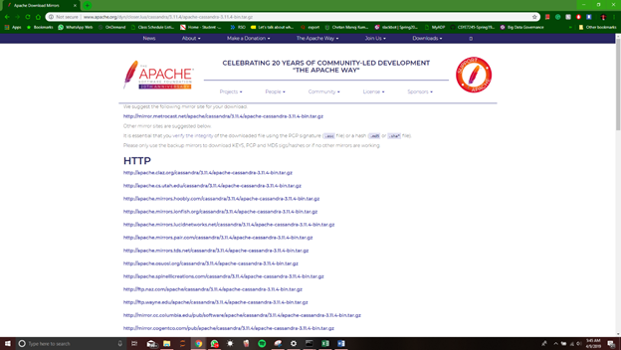
Download and Install Cassandra

Slide 38
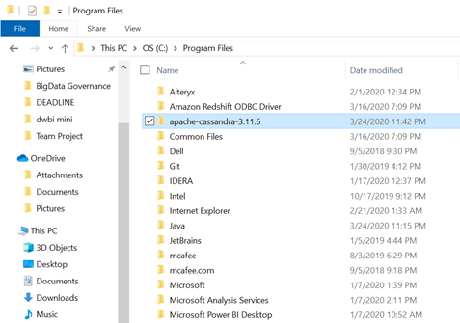
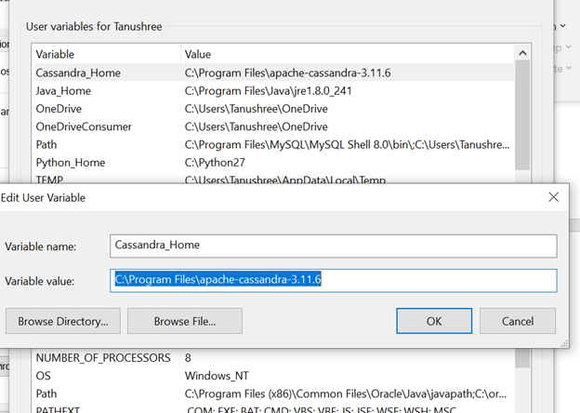
Downloading and installing Cassandra

Slide 39
Downloading and installing Cassandra
Install Python 2.7 , please make sure its not any higher version than this since only this version is compatible.
If you haven’t installed the python 2.7 then you need to install it and you can get the python 2.7 from this link
https://www.python.org/downloads/release/python-2716/
Once downloaded add the path of the python to the computer’s variable. go to start >> edit environment variables for your account >>
Click on path and then click on edit. >> add the python’s directory as its path

Slide 40
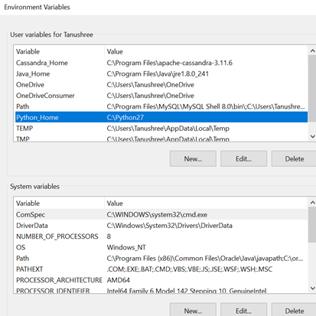
Downloading and installing Cassandra

Slide 41
Downloading and installing Cassandra
One of the additional component we need to install in this process is Apache Thrift which you can get it from this link “http://www.apache.org/dyn/closer.cgi?path=/thrift/0.12.0/thrift-0.12.0.exe”
Download and install it. You can just follow along the instructions by reading while installing.
Finally our Cassandra is installed!!

Slide 42
Data Integration and Mapping
We got clean data from python and then we had to integrate with our cassandra, so we first had to create a keyspace using a command:
CREATE KEYSPACE test WITH replication = {'class': 'SimpleStrategy', 'replication_factor' : 3};
After the key space is created, we need to create the tables where we can copy the csv files, so we create the table structures with all the columns same as the csv with accurate data type. So we write the create table query with all the columns from the csv and with all their respective datatype.

Slide 43
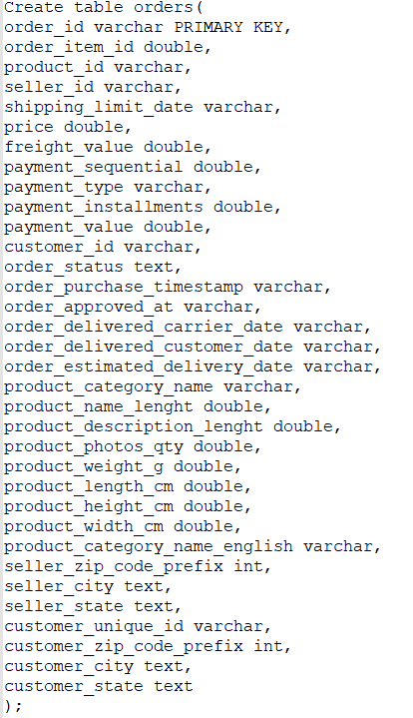
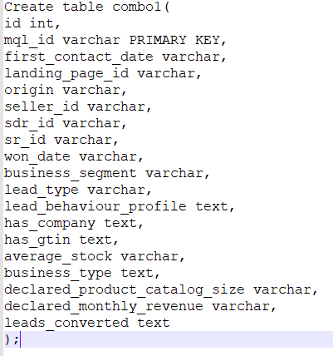
Data Integration and Mapping

Slide 44
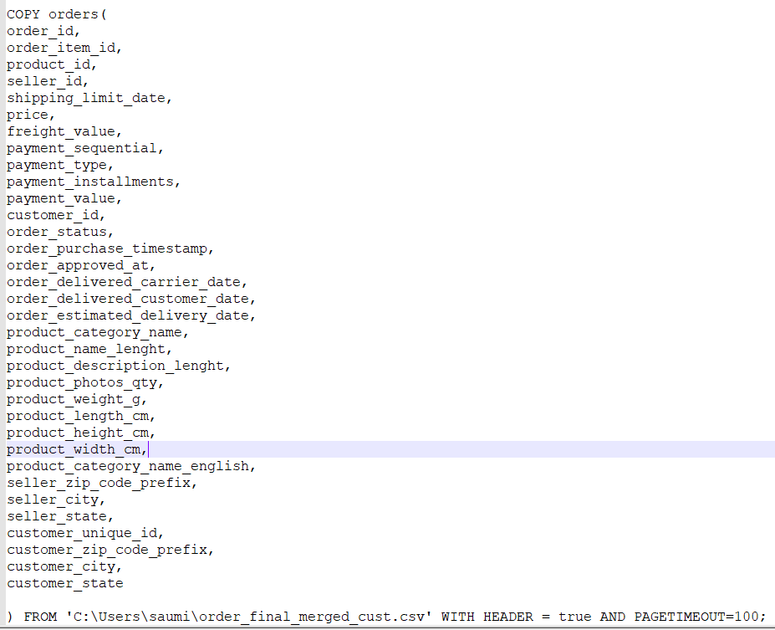
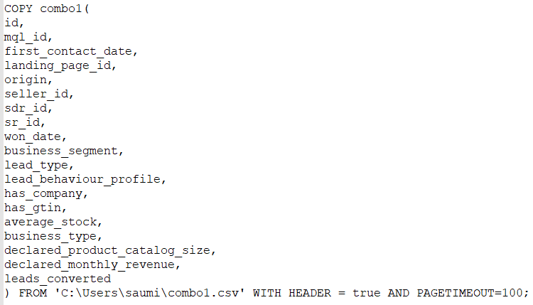
Data Integration and Mapping
Once we create the table structure we write the copy code and give the path of where the csv is stored so that the csv can be copied into the table created.
Once the files are copied to the tables we can check if all the content is present by writing a select count query if the row counts are correct.
Now to connect the tables to PowerBI we need to connect with the Simba ODBC connector, select the keyspace that we created and select the table we want to use for visualization.

Slide 45

Visualization Reports - Marketing Leads Analysis - Sales and Marketing Analysis - Finance and Operations Analysis

Slide 46
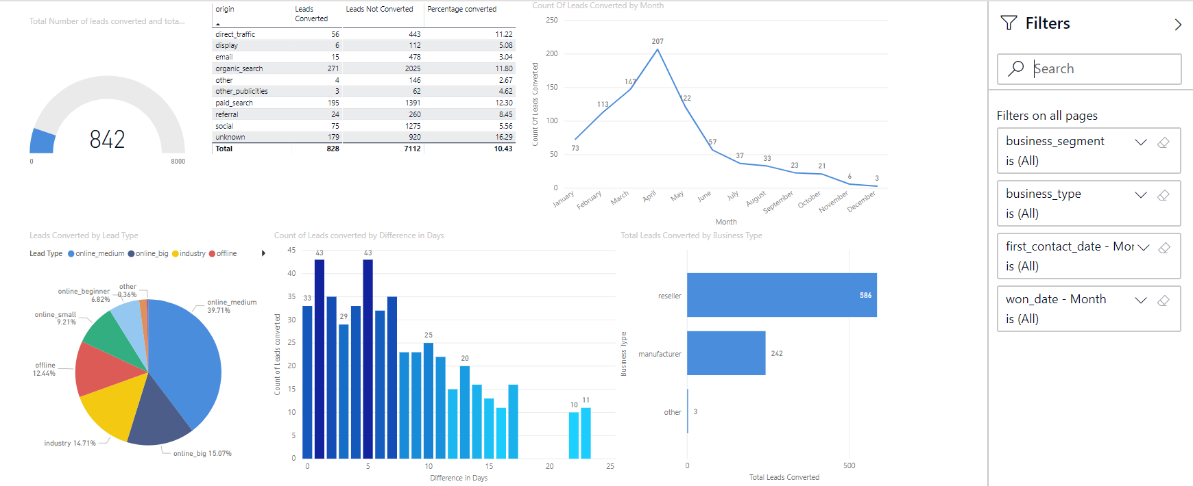
Marketing Leads Analysis - Report

Slide 47
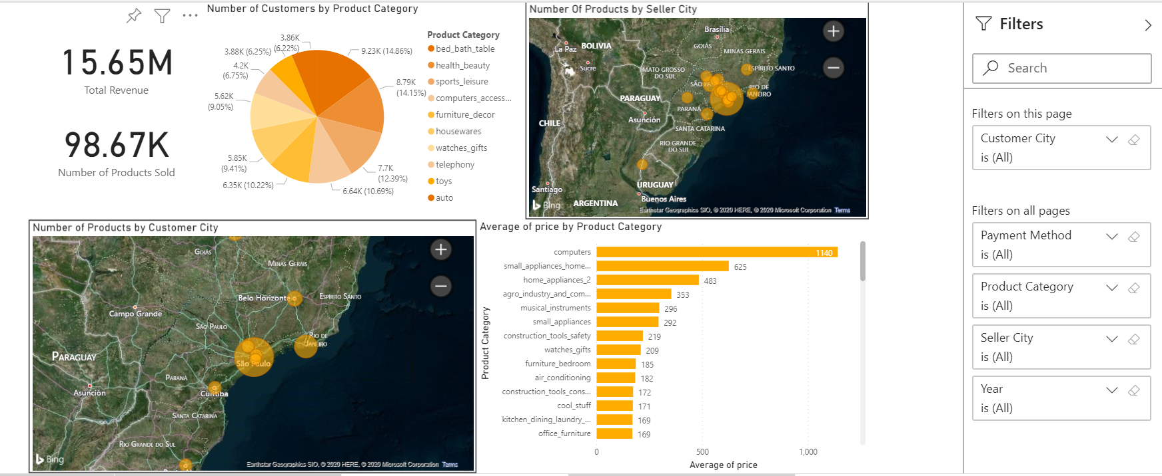
Sales and Marketing Analysis - Report

Slide 48
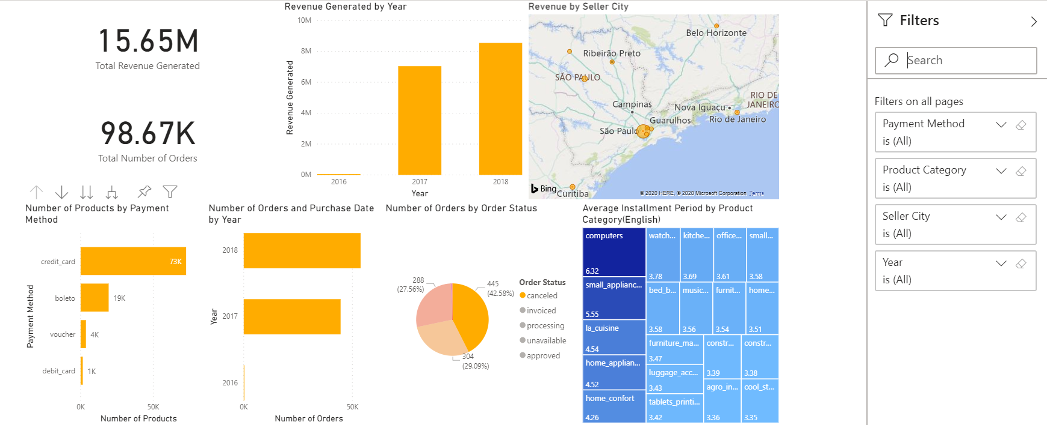
Finance and Operations Analysis – Report

Slide 49
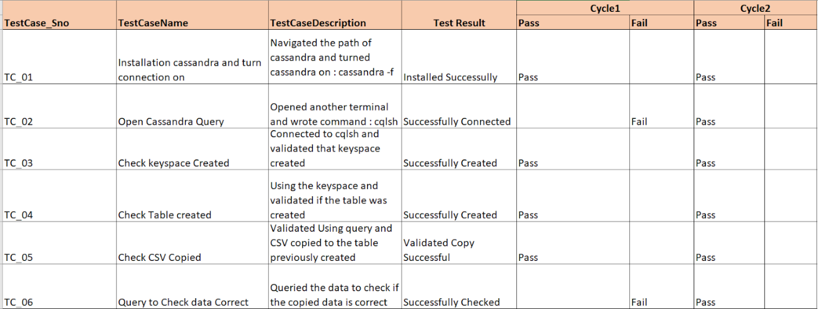
Test cases – System Integration and Unit Testing

Slide 50
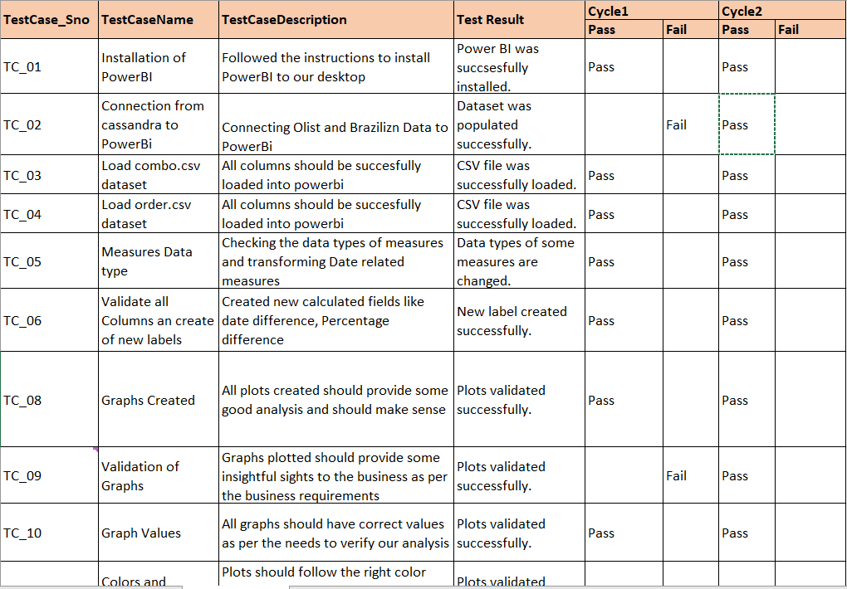
Test cases – System Integration and Unit Testing

Slide 51


